Slide 1
Ανανεώσιμες πηγές ενέργειας και βιώσιμη ανάπτυξη

Slide 2
Περιεχόμενα
Αντιμετώπιση της υπερθέρμανσης του πλανήτη
Γιατί ανανεώσιμες πηγές ενέργειας;
Επισκόπηση των ανανεώσιμων πηγών ενέργειας
Ηλιακή ενέργεια
Αιολική ενέργεια
Βιοκαύσιμα
Hydro
Οικονομικά των ανανεώσιμων πηγών ενέργειας

Slide 3
Energy Industry – The Ecosystem
Energy Industry
Non-Renewable
Coal
Oil & Gas
Renewable Energy
Solar
Bio-fuels
Wind
Hydro
Associated Equipment/ Technology Suppliers
Utilities/
Consumers
Others (Fuel Cells, Geothermal etc.)

Slide 4
Energy Composition
Η αμερικανική και ευρωπαϊκή παραγωγική ικανότητα κυριαρχείται από την καύση ορυκτών καυσίμων, αν και παρατηρείται στροφή προς τη δημιουργία μη ορυκτών καυσίμων
Notes:
Can introduce graph from IEA that shows shift

Slide 5
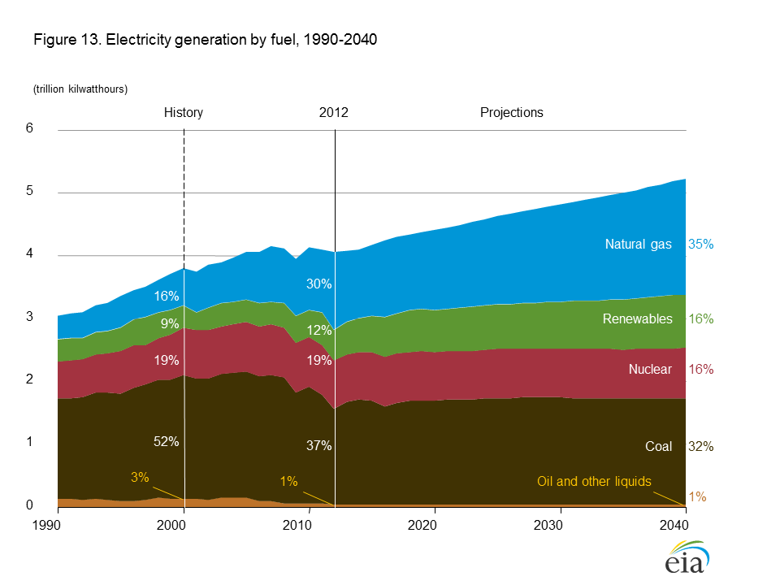
Πηγές για την παραγωγή ηλεκτρικής ενέργειας στις ΗΠΑ
Notes:
Can introduce graph from IEA that shows shift

Slide 6
Αντιμετώπιση της υπερθέρμανσης του πλανήτη
Ζήτηση
Παραγωγή ενέργειας από καθαρότερες πηγές όπως αιολική, ηλιακή, βιοκαύσιμα, πυρηνικά κλπ.
Προσαρμογή
Μέτρα όπως η ενίσχυση της άμυνας κατά των πλημμυρών ώστε να προσαρμοστούν στις επιπτώσεις της κλιματικής αλλαγής
Αποδοτικότερες συσκευές και μικρότερη ζήτηση από τους καταναλωτές
Προσφορά
Λάμπες εξοικονόμησης ενέργειας, αποδοτικότερα κλιματιστικά και καταψύκτες κλπ.
Σχεδόν το 80% των προβλεπόμενων μειώσεων του CO2 έως το 2030 θα προκύψει από την αποτελεσματικότητα της ζήτησης
Παραγωγή ενέργειας πιο αποτελεσματικά
Μειώστε τις εκπομπές
Μειώστε την αποδάσωση
Μείωση εκπομπών CO2

Slide 7
Projected CO₂ Reductions from Various Sources
Source - IEA

Slide 8
Renewables - There is an alternative

Slide 9
Why Renewables?
Do not deplete natural resources
Global warming has hit the public (and political?) conscience
Effective method to reduce CO₂ emissions
Guarantee Energy security for countries deploying it
Legislation being passed making renewables more attractive

Slide 10
Key Renewable Energy Sources
Solar Power
Photovoltaic
Solar-thermal
Wind Power
Onshore
Biofuels
Agricultural crops (1st Gen)
Cellulosic feedstock (2nd Gen)
Offshore
New feedstock such as Algae (3rd Gen)
Hydro Power

Slide 11
Solar Power
Solar energy is generally captured in two forms: via photovoltaic cells for electricity generation or via thermal panels for heating purposes
Remains an expensive method of generating electricity compared to conventional sources and other renewable sources such as wind or hydro power
Recent advances in technology and support from certain governments have continued to drive solar penetration

Slide 12
Solar Power - Photovoltaic
Current is generated through Photovoltaic effect -flow of free electrons in Silicon Panel due to solar irradiance
Direct current (DC) is generated which can be stored in a battery or converted to Alternating Current (AC)

Slide 13
Solar Power – Solar Thermal
Sun’s infrared rays are concentrated through reflecting mirrors on a heating fluid (normally liquid salt) medium, which in turn generates steam to propel turbines

Slide 14
Pros - Solar
Most widely available source of energy
Not as limited in location siting as other renewable sources such as Wind & Hydro
Largest potential for decentralized power generation
Solar thermal technology characteristics attractive owing to ability to store energy
Scaling up (& down) very easy for Solar PV
Increased demand driving down costs (grid parity?)

Slide 15
Cons - Solar
Most expensive form of energy (though not so much if you consider end-to-end costs of other energy sources)
Large up-front Capital investment
Cannot contribute to base-load power (until further improvements in energy storage)
Imposes great stress on the grid owing to fluctuating nature
Solar PV - Difficult to store energy in electric form

Slide 16
Key Trends & Players
Beyond 2009, Photovoltaic Markets Are Expected to See Healthy Growth
Source: BCG Analysis

Slide 17
Regulations
The US market is regulated by bidding procedures which award very competitive projects achieving costs of $0.12 per kWh or less
At the federal level various tax rebate systems are in place, though these could be at risk after the last congressional elections shifted the balance of power in Washington.
Depending on the system size, different policy strategies apply.
Systems below 1MW can benefit from a net-metering system

Slide 18
Wind Power
Converts kinetic energy for wind to electrical energy
Broadly serving as the renewable of choice in Europe and the United States
Increased size and higher productivity have enabled wind generation to become an increasingly competitive alternative to more traditional methods of power generation
Uncertainty is the main problem with wind production owing to the inherent unpredictability of weather conditions
Utilization for wind generation is generally rather low, with most in the 25-35% utilization rate

Slide 19
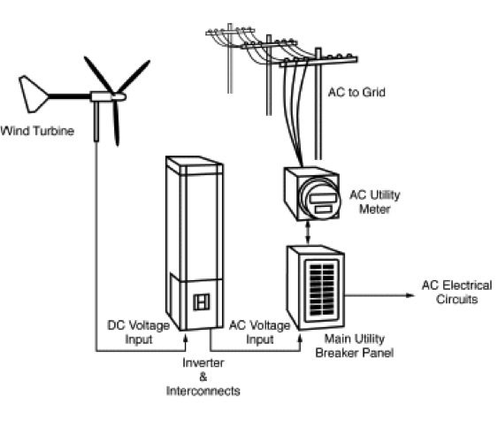
Wind Power

Slide 20
Pros - Wind
Smaller Land requirement when compared to Solar, Hydro
Can be built off-shore
Fluctuates less than solar
Cheaper than Solar

Slide 21
Cons - Wind
Premium Onshore sites saturated
Intermittency issue
Offshore towers more expensive
Energy Storage not viable
Cause Noise pollution

Slide 22
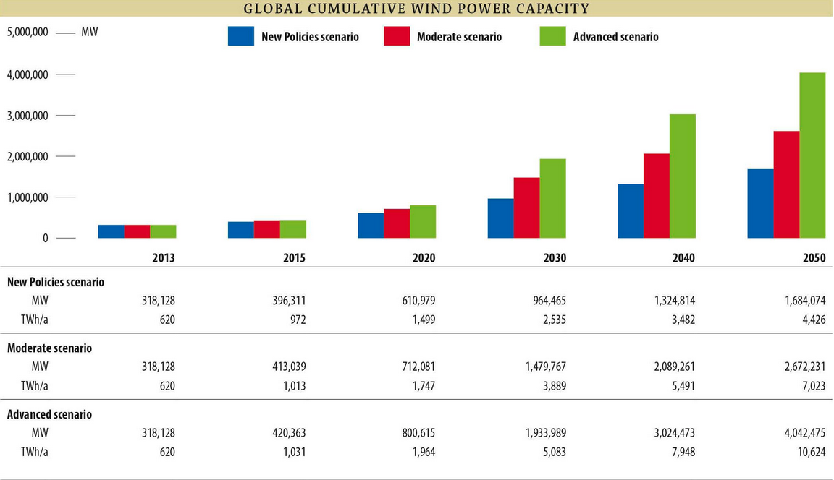
Projected Global Capacity - Wind
Source: Global Wind Energy Council, Global Wind Energy Outlook 2014

Slide 23
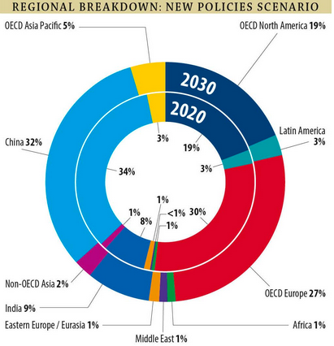
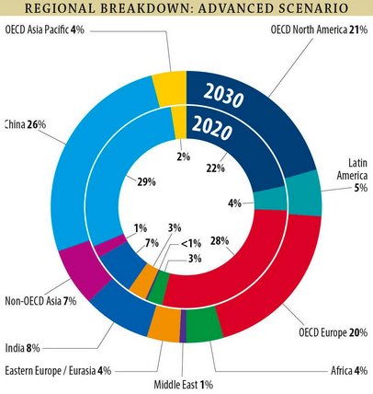
Key Trends & Players - Wind
Source: Global Wind Energy Council, Global Wind Energy Outlook 2014

Slide 24
Regulations - USA
State Renewable energy policies mandate a certain % of electricity sales come from wind energy sources. Under these 14 states have >1000MW of Wind Capacity
Texas approved a $4.93 billion expansion of the state’s electric grid to bring wind energy to its major cities
Federal production tax credit (PTC) of @21 per MWh generated for the first ten years of operation for Wind energy sold

Slide 25
Biofuels
Ethanol is an alcohol distilled from plant material (corn in the U.S., sugar cane in Brazil, wheat in Europe) and used as gasoline substitute or blend stock
U.S. and Brazil account for 90% of global ethanol production and consumption
Ethanol can be blended to around 10% of the gasoline pool without any noticeable impact on vehicle performance, but higher blend proportions require some engine modifications
Biodiesel is produced by the transformation of animal fat or vegetable oil into a conventional diesel substitute
Feedstock represents more than 80% of the total costs of producing biodiesel compared with around 60% for ethanol

Slide 26
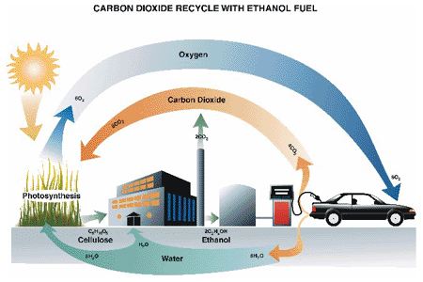
Bio-fuels

Slide 27
Pros - Biofuels
Inherently renewable
Emit less particulate pollution than traditional petroleum based gasoline and diesel fuels
Easier to transition to without special infrastructure needs

Slide 28
Cons - Biofuels
Not enough land space to grow crops for biofuel demand
Question over whether producing them actually requires more energy than they generate
Still polluting when compared to wind or solar

Slide 29
Key Trends & Players - Biofuels
Source: Concentric Energies & Resource Group, Inc – US Biofuels Industry Report

Slide 30
Hydroelectric

Slide 31
Characteristics
Most mature of renewable energies
Largest global contributor amongst all renewable energies
Largely utilizes established technology from other sectors
Can be “switched on-off” at almost immediately
Arguably the Cheapest where available

Slide 32
Pros - Hydroelectric
Cheap electricity
Capable of providing base load power
Capable of large scale production

Slide 33
Cons - Hydroelectric
Environmental concerns. Ecology in dam catchment area destroyed
Humanitarian implications. Settlements in catchment areas have to be relocated
Depends on seasonal nature of water (rain) availability in catchment area
High upfront capital investment costs
Limited in number of potential sites/locations

Slide 34
Key Trends & Players - Hydroelectric

Slide 35
Renewables – Economics

Slide 36
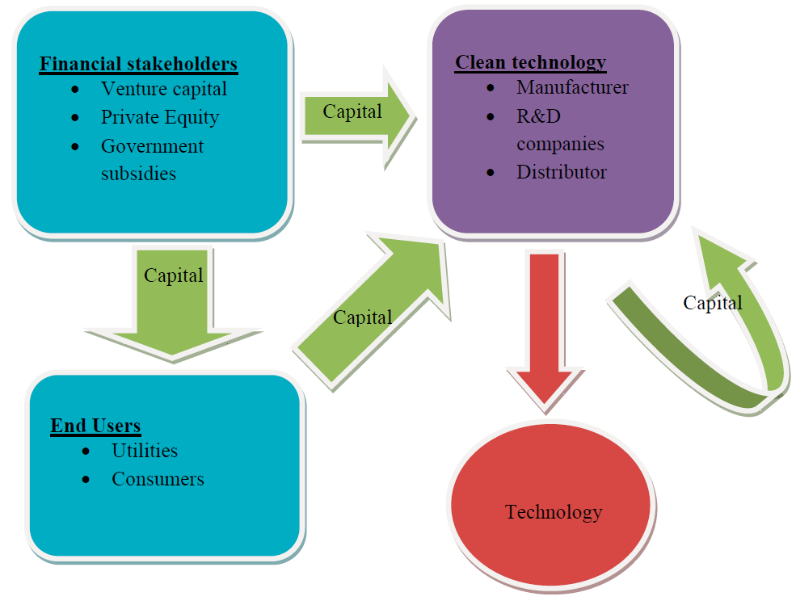
Clean-Tech Investment Chain

Slide 37
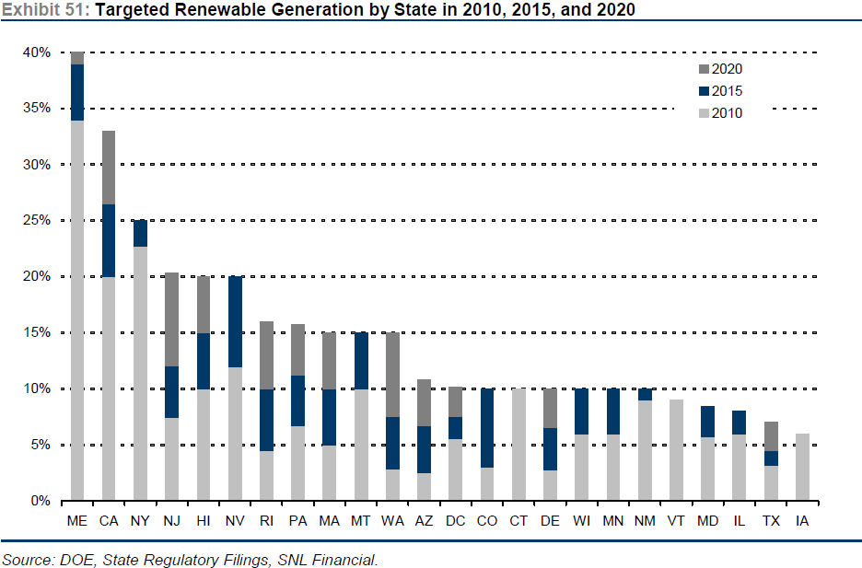
Targeted Renewable Generation by State
Renewable Energy Generation by State (2014)

Slide 38
Cost – Renewables versus Non-renewables

Slide 39
U.S. Utilization by Plant Type

Slide 40
Cost of Capacity per kW -Utilization Adjusted

Slide 41
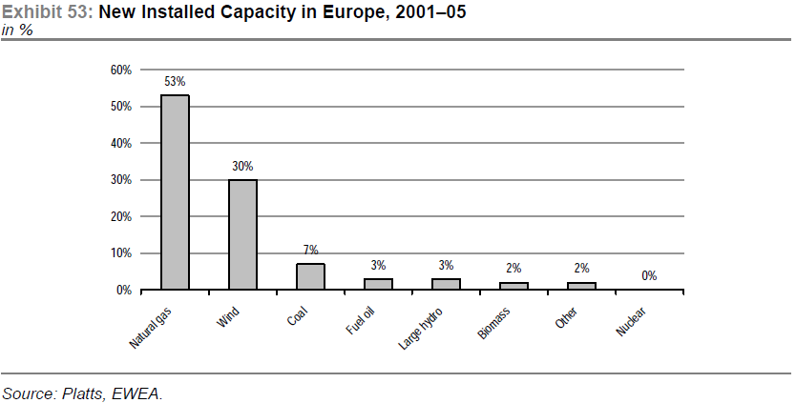

Slide 42
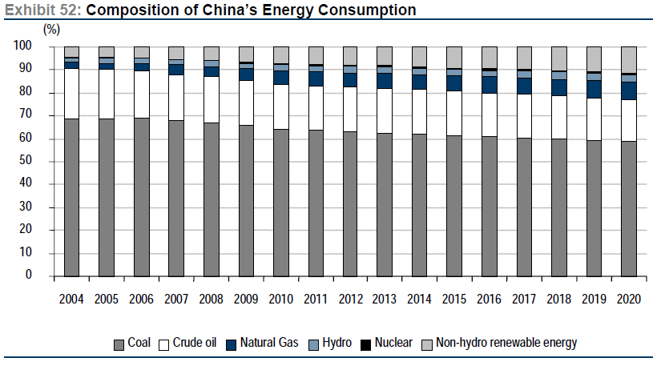

Slide 43
