Slide 1
ISLAMIC LIBERATION THEOLOGY
PART II

Slide 2
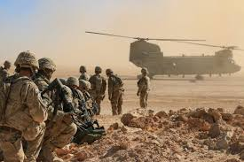
WAR ON TERRORISM/WAR ON TERROR/WAR OF TERROR/WAR OF TERRORISM

Slide 3
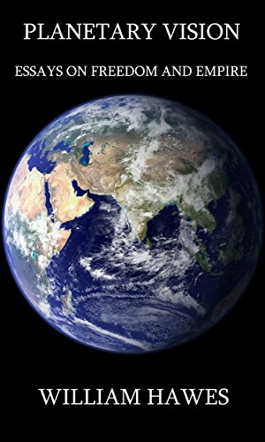
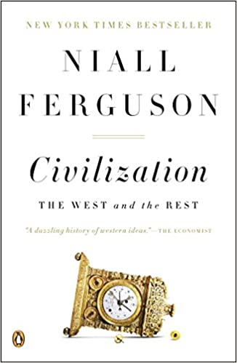
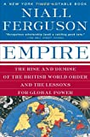
PLANETARY VISION – DISTORTING PARALLELS

Slide 4
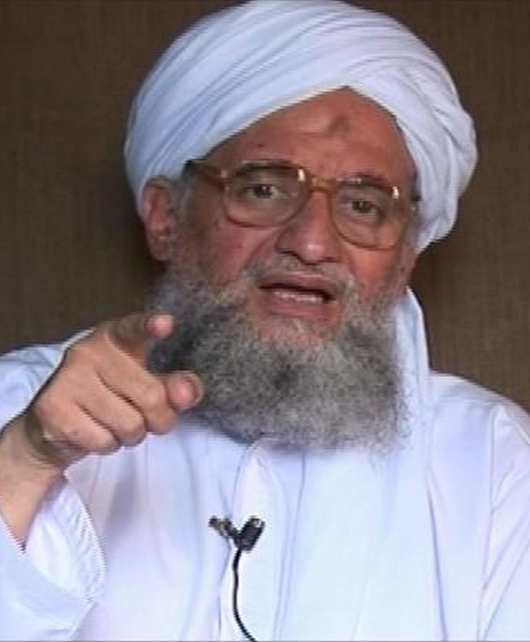
LUXURIANT ADVENTURISM

Slide 5
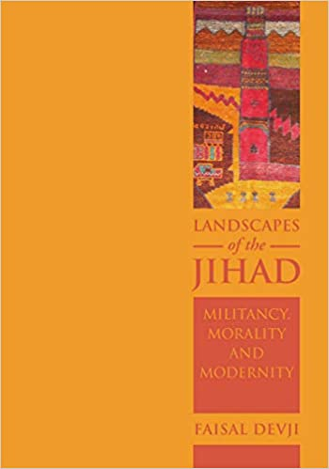
OF THE BIN LADEN VARIETY

Slide 6
Al-Qaeda with its decentralized structure actually has more in common with multinational corporations, antiglobalization activists, and environmentalist and social justice organizations. Bin Laden and his lieutenants view their cause as a response to the oppressive conditions faced by the Muslim world rather than an Islamist attempt to build states. Al-Qaeda culls diverse symbols and fragments from Islam's past in order to legitimize its global war against the "metaphysical evil" emanating from the West. The most salient example of this assemblage, Devji argues, is the concept of jihad itself, which Al-Qaeda defines as an "individual duty" incumbent on all Muslims, like prayer. Although medieval Islamic thought provides precedent for this interpretation, Al-Qaeda has deftly separated the stipulation from its institutional moorings and turned jihad into a weapon of spiritual conflict.

Slide 7
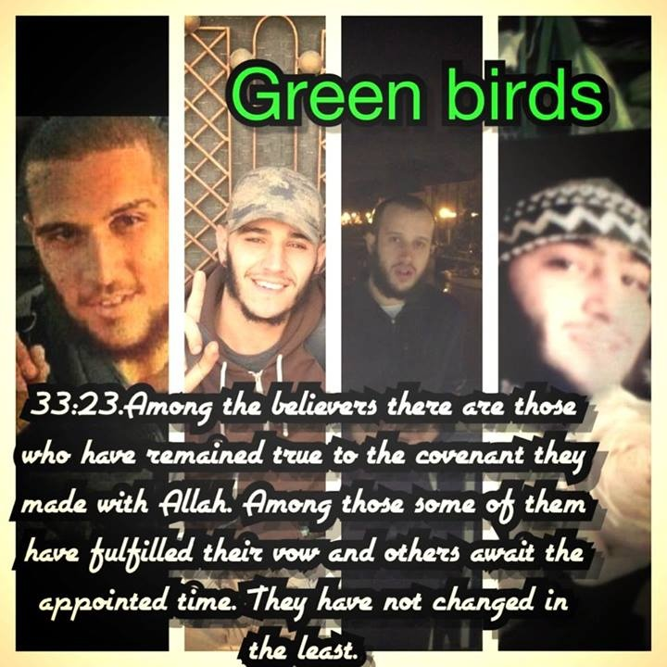

Slide 8
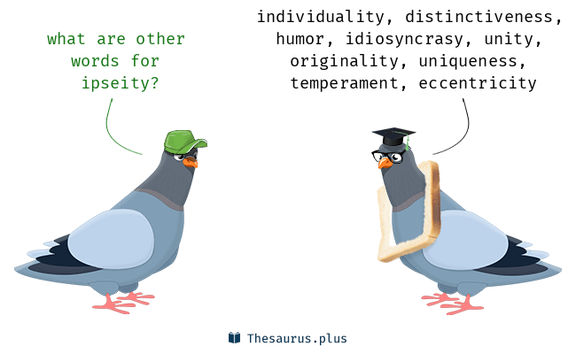
ALTERED IPSEITY
Definition of ipseity: individual identity - selfhood “those heavenly moments … when a sense of the divine ipseity invades me” — L. P. Smith

Slide 9
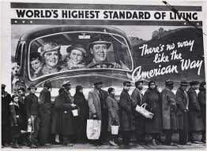
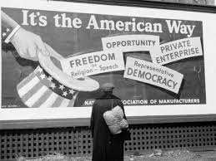
THE AMERICAN WAY

Slide 10
The Saudi family
The House of Saud (Arabic: آل سُعُود‎, romanized: ʾĀl Suʿūd IPA: [ʔaːl sʊʕuːd]) is the ruling royal family of Saudi Arabia. It is composed of the descendants of Muhammad bin Saud, founder of the Emirate of Diriyah, known as the First Saudi state (1744–1818), and his brothers, though the ruling faction of the family is primarily led by the descendants of Ibn Saud, the modern founder of Saudi Arabia. The most influential position of the royal family is the King of Saudi Arabia. The family in total is estimated to comprise some 15,000 members, however the majority of power, influence and wealth is possessed by a group of about 2,000 of them.

Slide 11
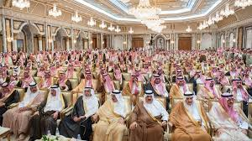
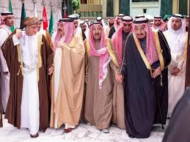

Slide 12
FLOATING IN THE STREETS
Hurricane Katrina, tropical cyclone that struck the southeastern United States in late August 2005. The hurricane and its aftermath claimed more than 1,800 lives, and it ranked as the costliest natural disaster in U.S. history.

Slide 13
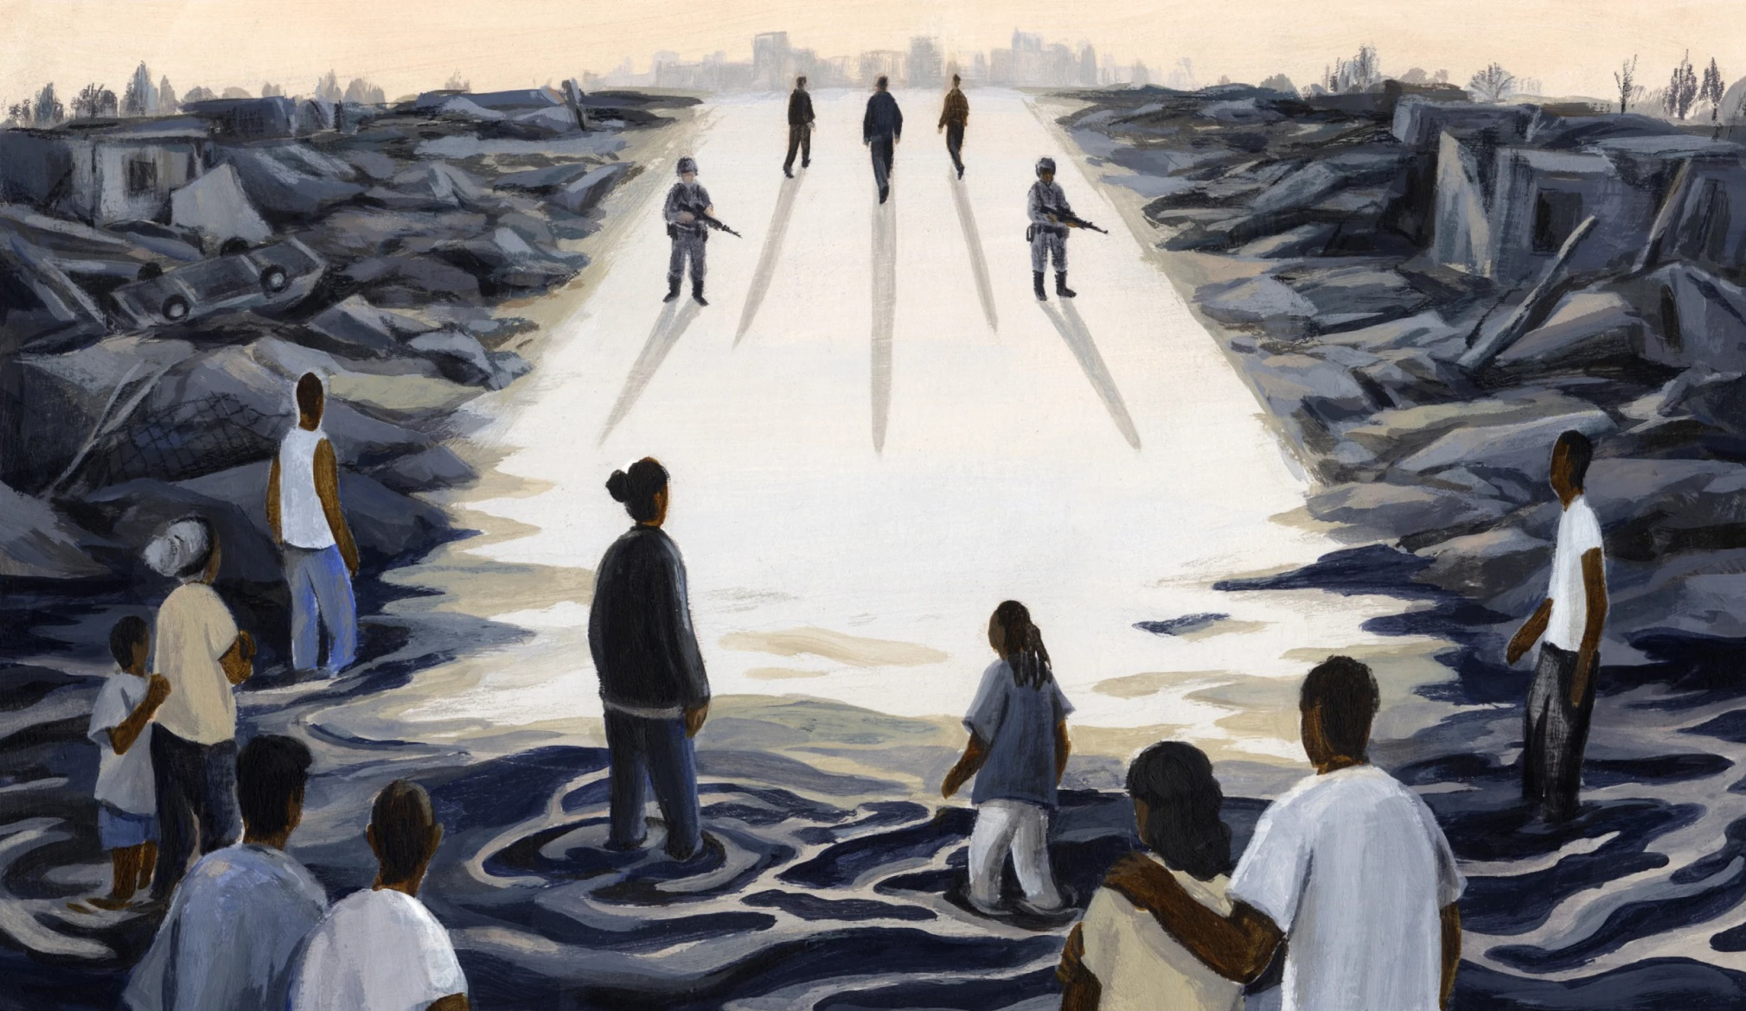
WHY KATRINA WAS NOT A NATURAL DISASTER

Slide 14
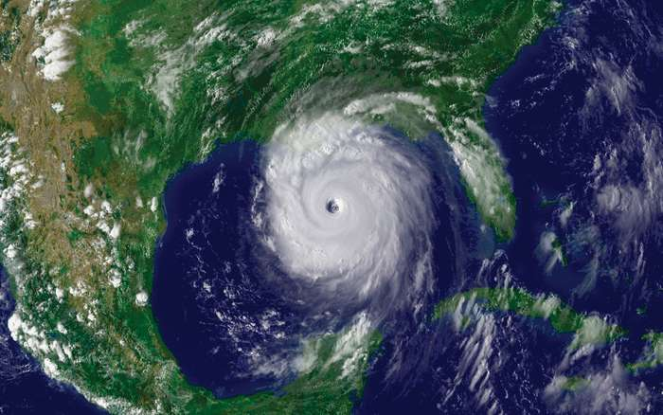

Slide 15
