Slide 2
DS14
Towards effective and adaptive
management measures for highly
mobile species
National Marine Park of Zakynthos
Greece

Slide 3
DS14 - Title of session
Adaptive management as a prerequisite for effective conservation of marine turtles in the area of the National Marine Park of Zakynthos
National Marine Park of Zakynthos
Greece

Slide 4
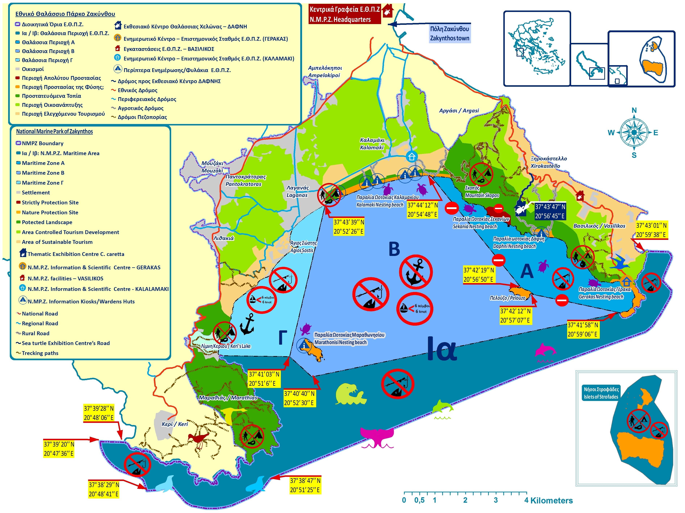
MPA/Organisation profile
MPA/Organisation profile
MANAGEMENT AGENCY (established in 2000)
Administrative and scientific staff : 13
Wardens: 19 + 23 seasonal wardens
Management Board : 1 president, 10 members
PROTECTED AREA
Marine area : 89 km²
Terrestrial area : 14.2 km²
Peripheral area: 31 km²
Natura 2000: 2 Site of Community interest
1 Site Special Protected Area
Priority species: Loggerhead Sea Turtle (Caretta caretta), Monk seal (Monachus monachus), Cory's shearwater (Calonectris diomeda), Eleonora’s falcon (Falco eleonora)
Priority habitats : Posidonia beds, Calcareous fens with Cladium mariscus
Number of Loggerhead Sea Turtle nests (average): 1200
Importance nesting activity: It is estimated that Zakynthos hold about 30 - 40 % of the Greek nests and about 20% of the nesting effort in the Mediterranean

Slide 5
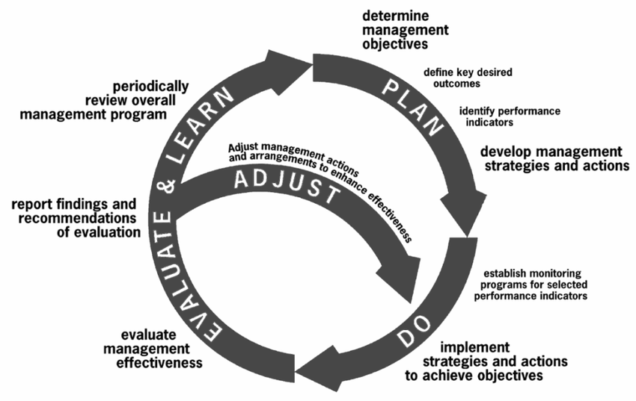
Context and issue

Slide 6
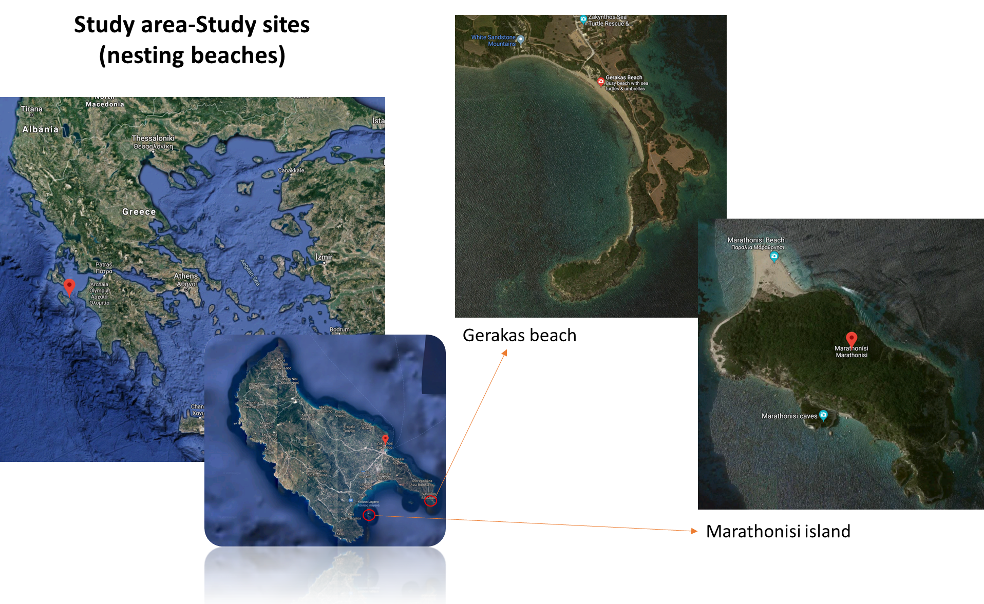
Context and issue

Slide 7
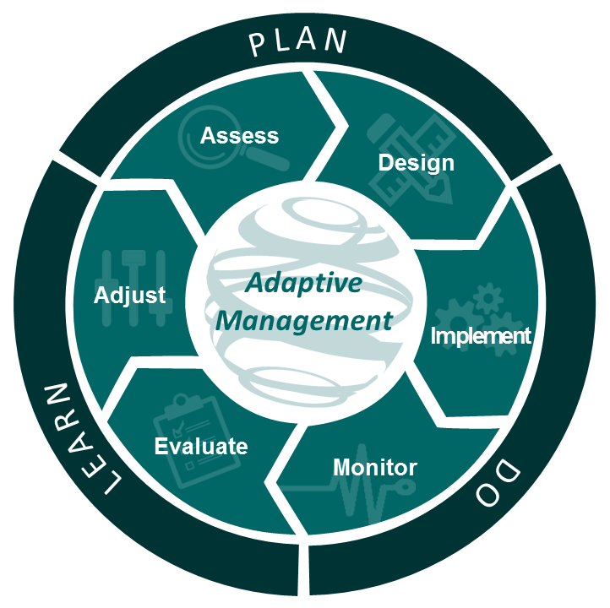
Context and issue
Develop a set of methodological, innovative tools for recording, capturing and collecting ecological, environmental and socio-economic parameters and processes related to the adaptive management of marine turtle nesting sites.

Slide 8
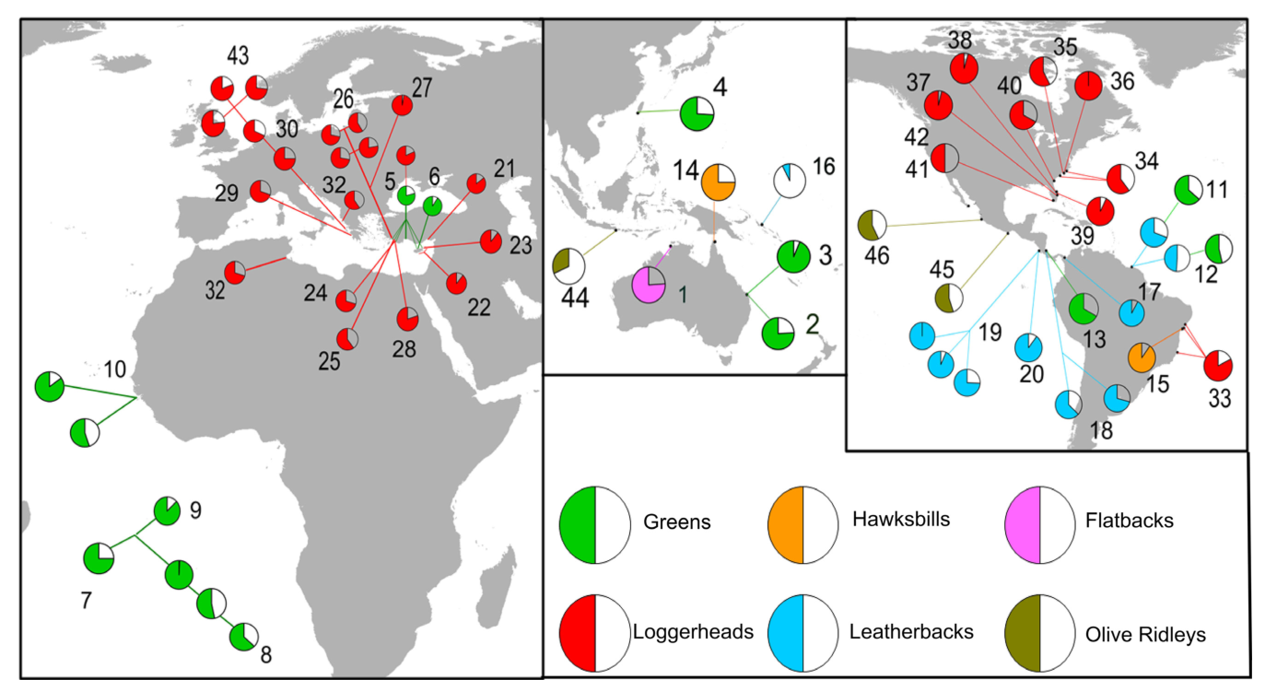
Results
Objective: Thermal profiles of nesting sites
Related to:
Sex ratio , Reproductive success, Robustness of hatchlings
Hatchling sex ratios recorded for sea turtle populations around the globe. The estimated proportion of females are presented as the filled slices of the pie charts; different species are presented under different colors.
Hays, Mazaris, Schofield, 2014

Slide 9
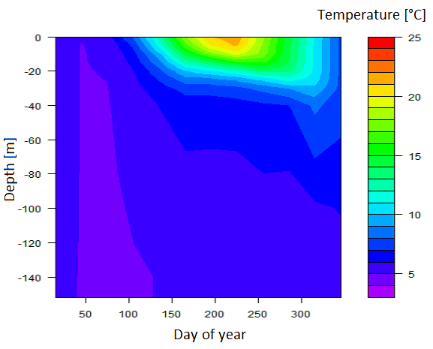
Results
Objective: Thermal profiles of nesting sites
Ensure
spatial coverage
precision
flexibility
seasonal patterns

Slide 10
Results

Slide 11
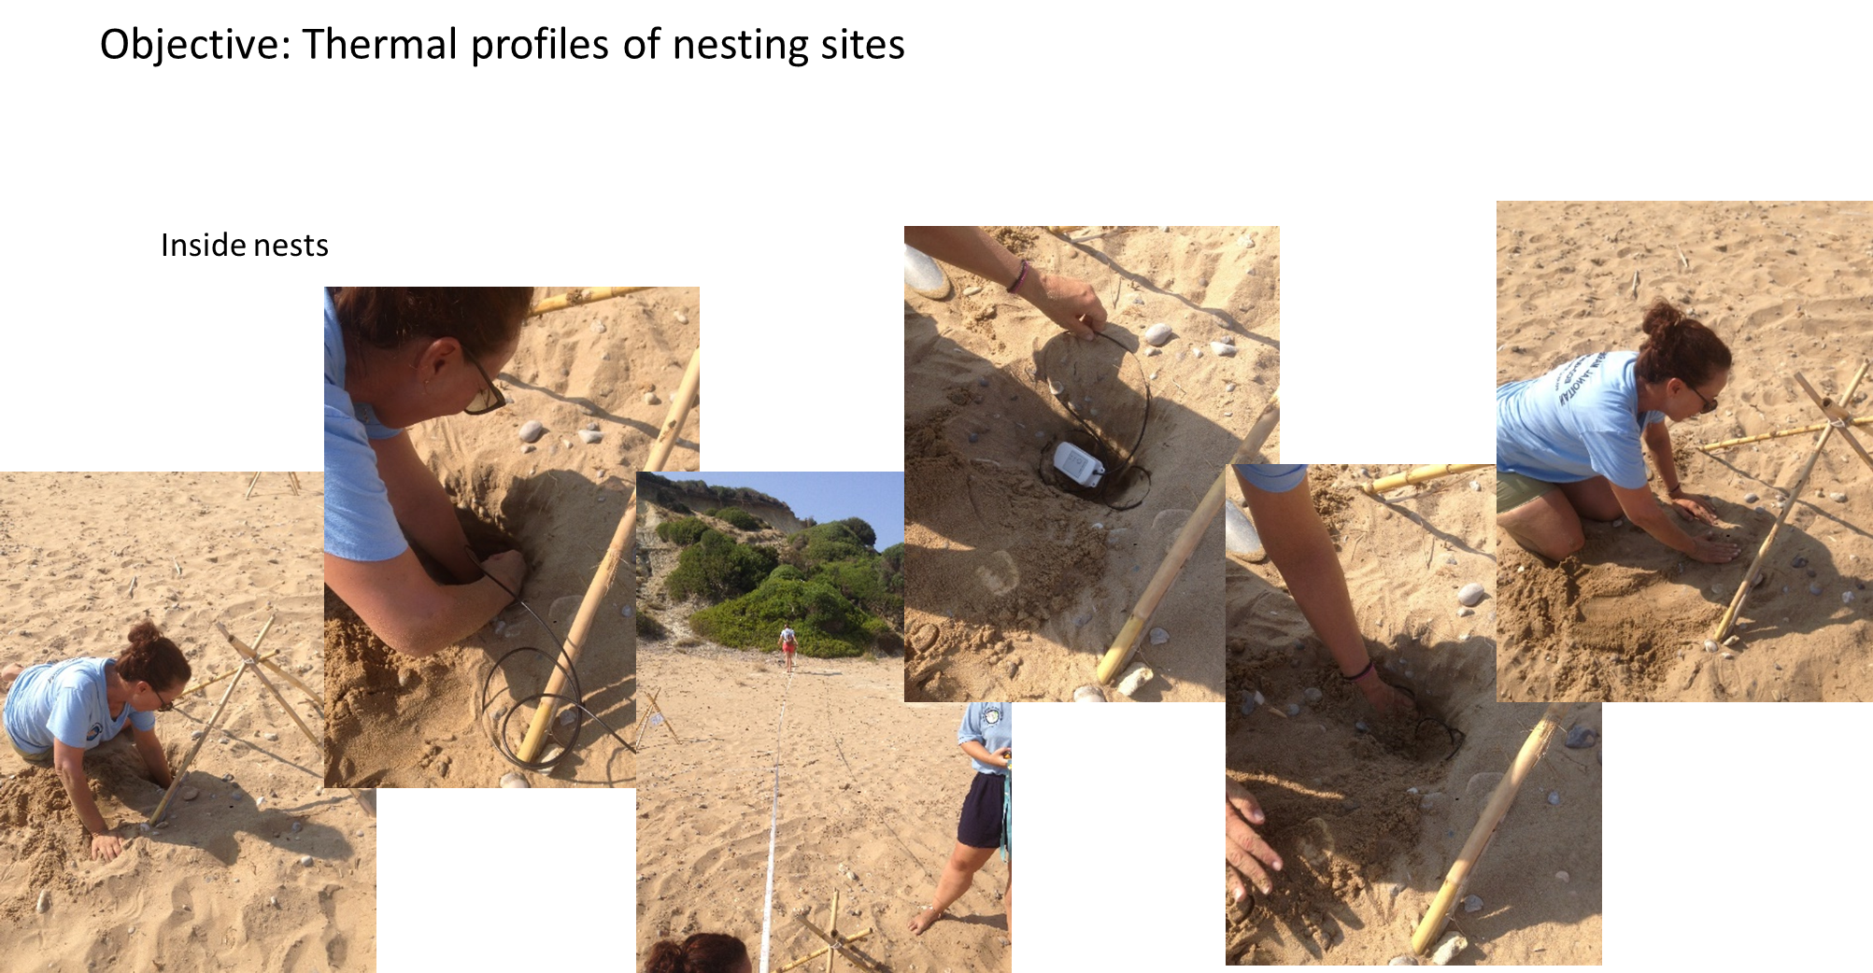
Results

Slide 12
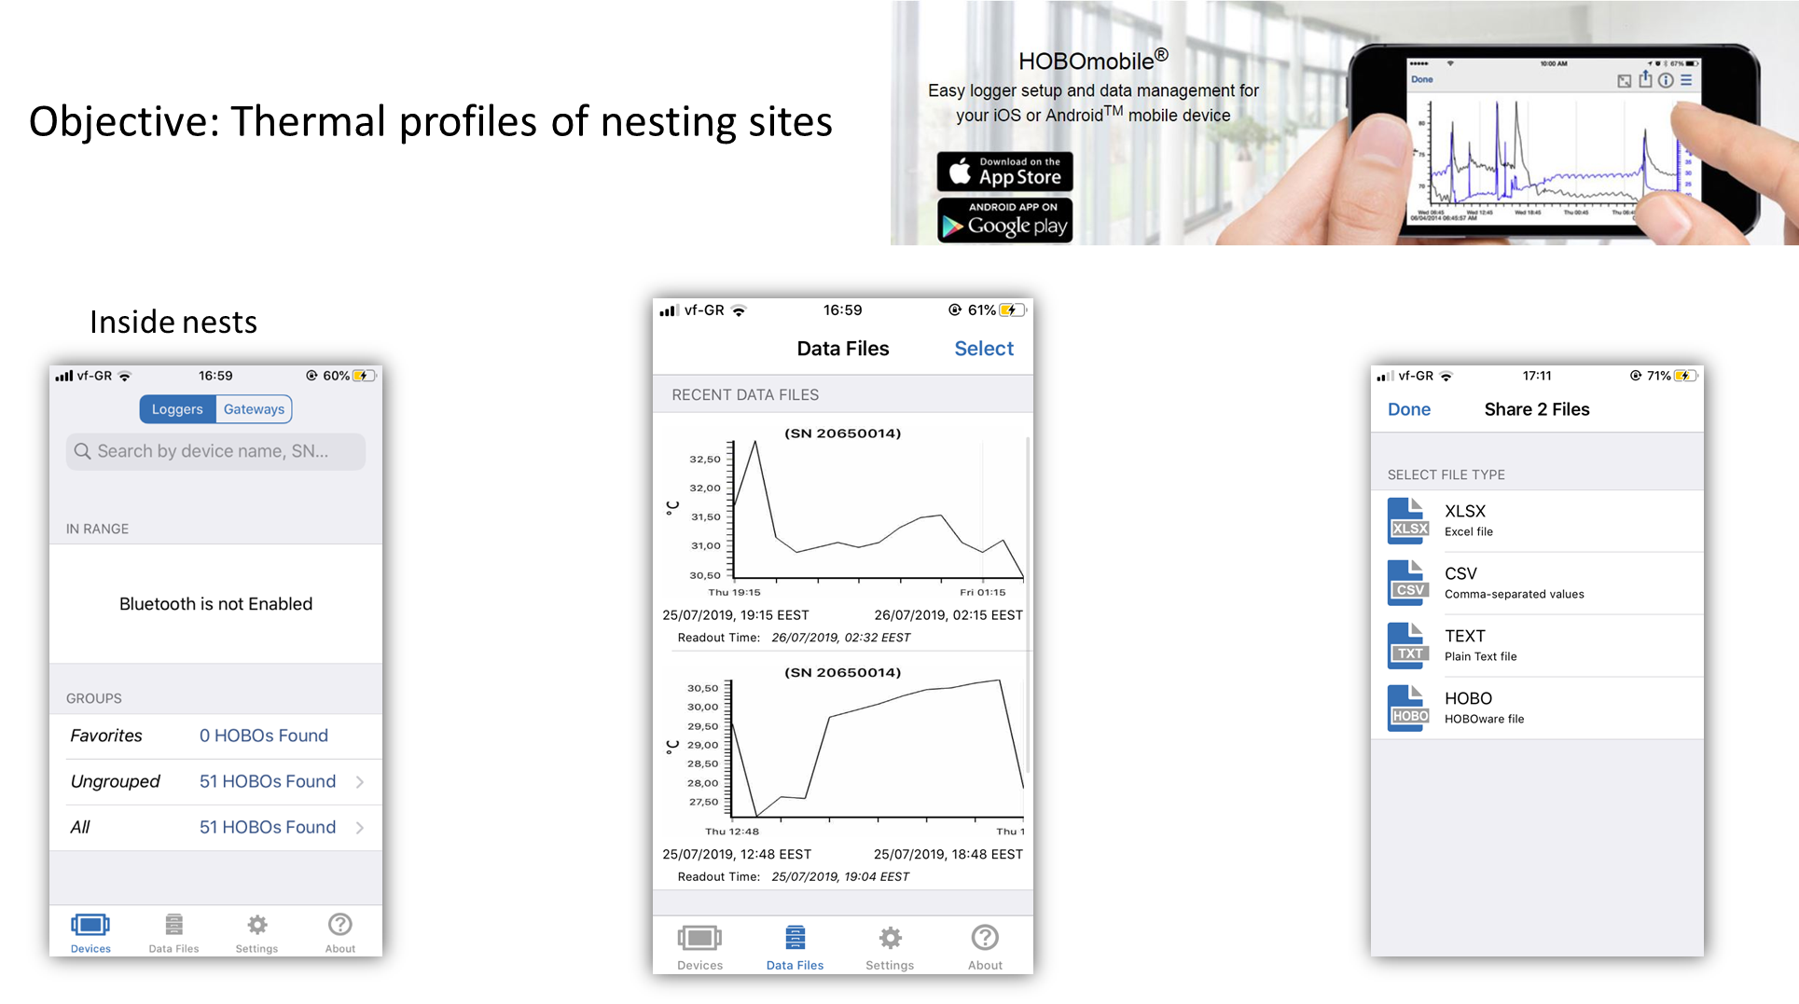
Results

Slide 13
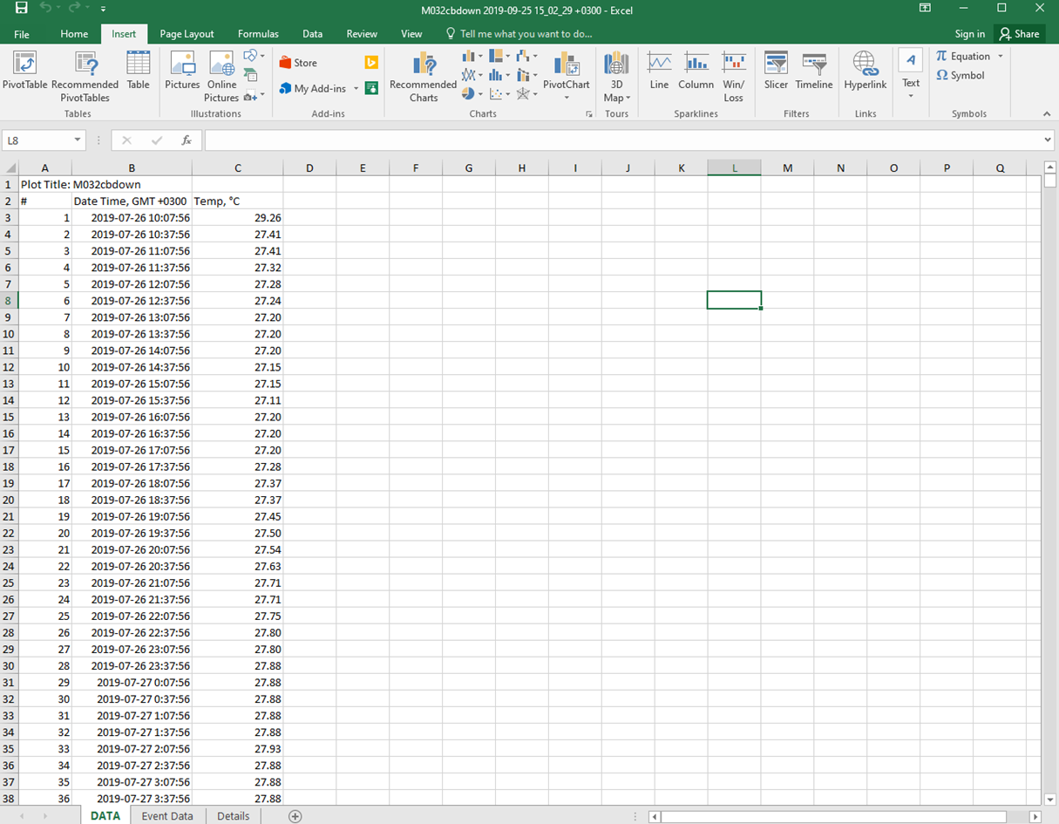
Results

Slide 14
Results

Slide 15
Results

Slide 16
Results

Slide 17
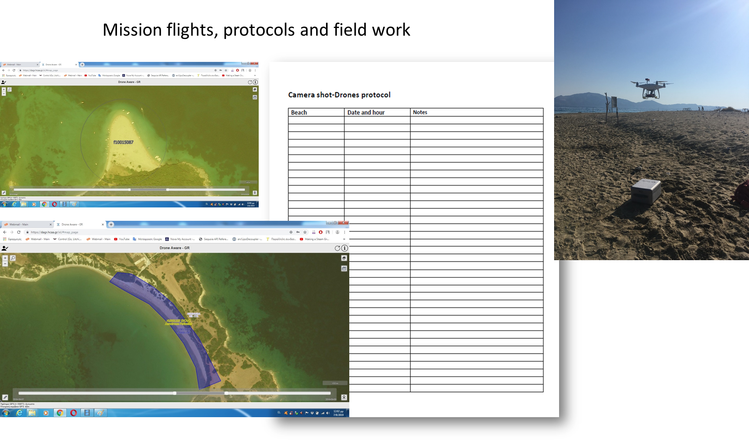
Results

Slide 18
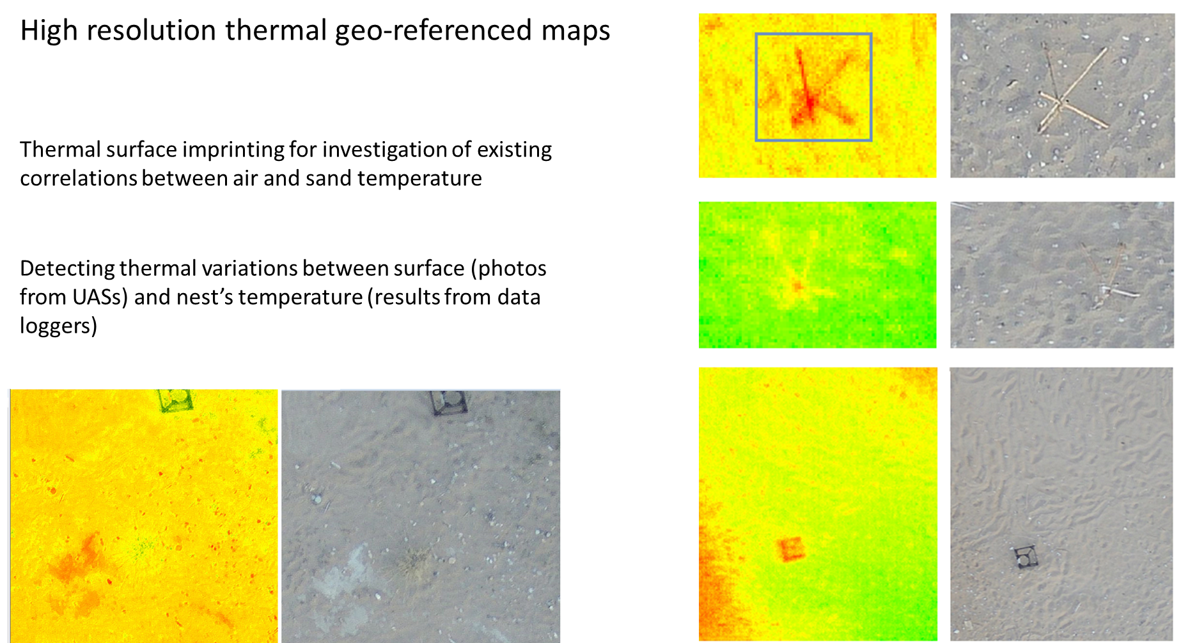
Results

Slide 19
Results

Slide 20
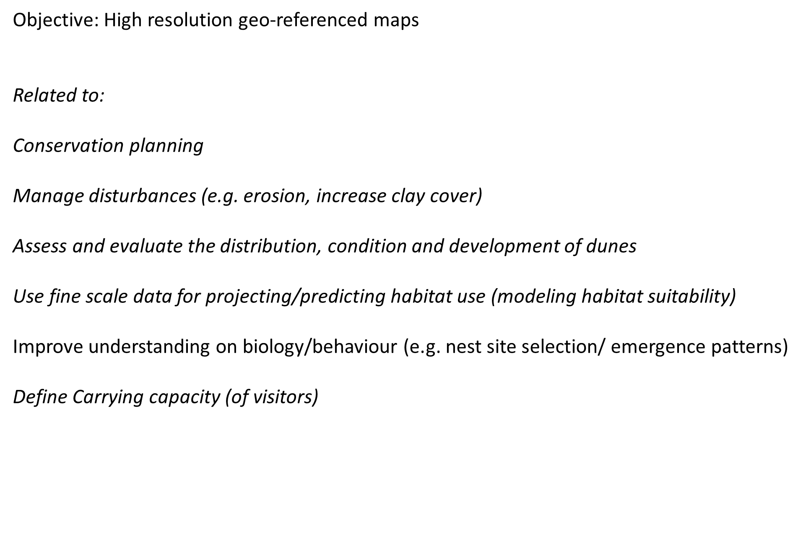
Results

Slide 21
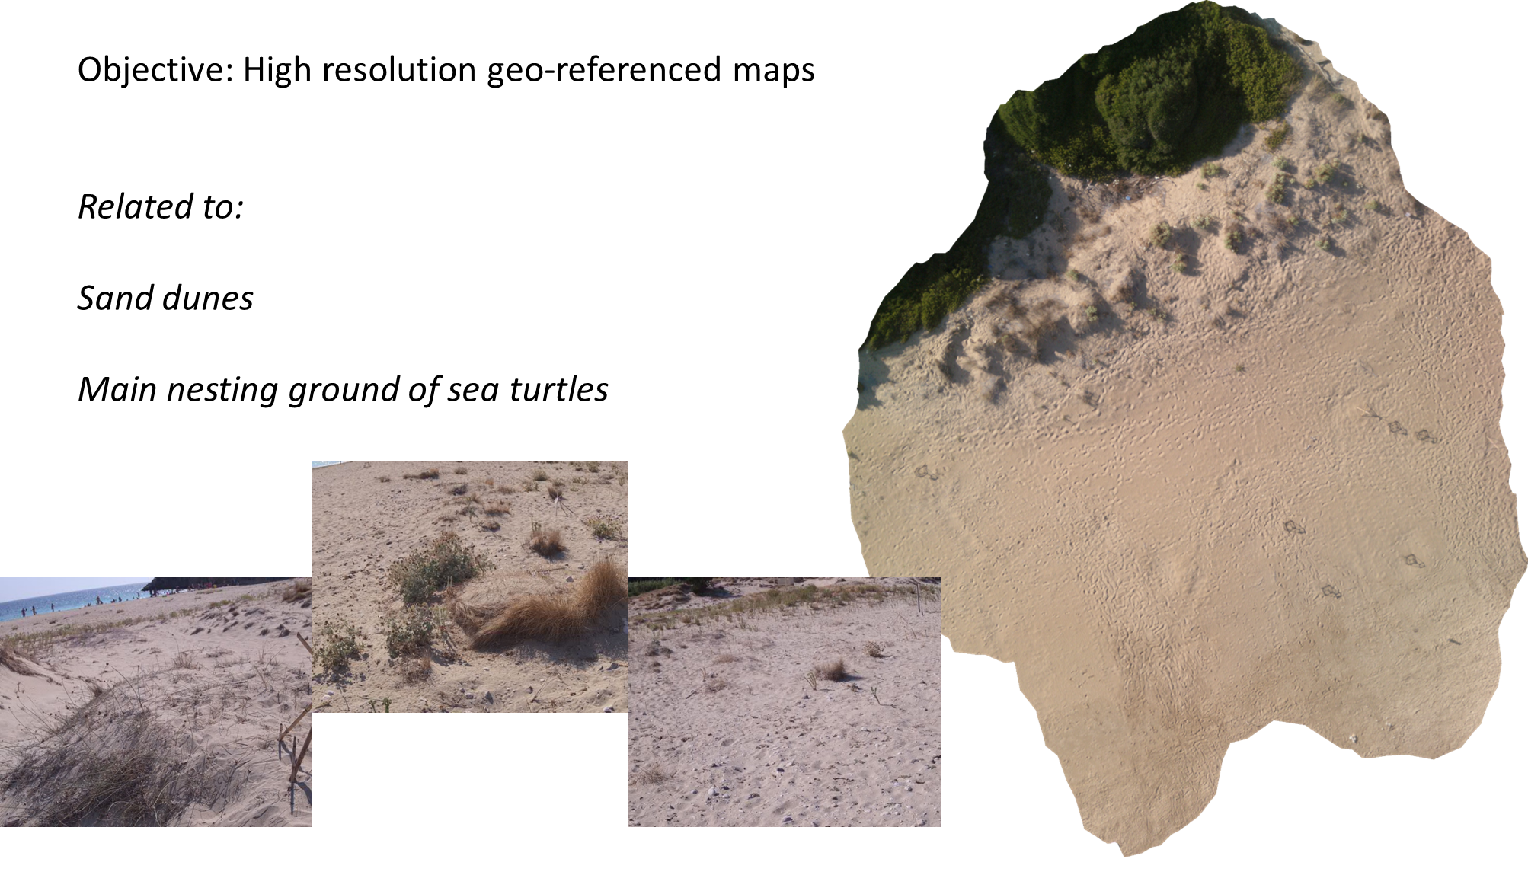
Results

Slide 22
Results

Slide 23
Results

Slide 24
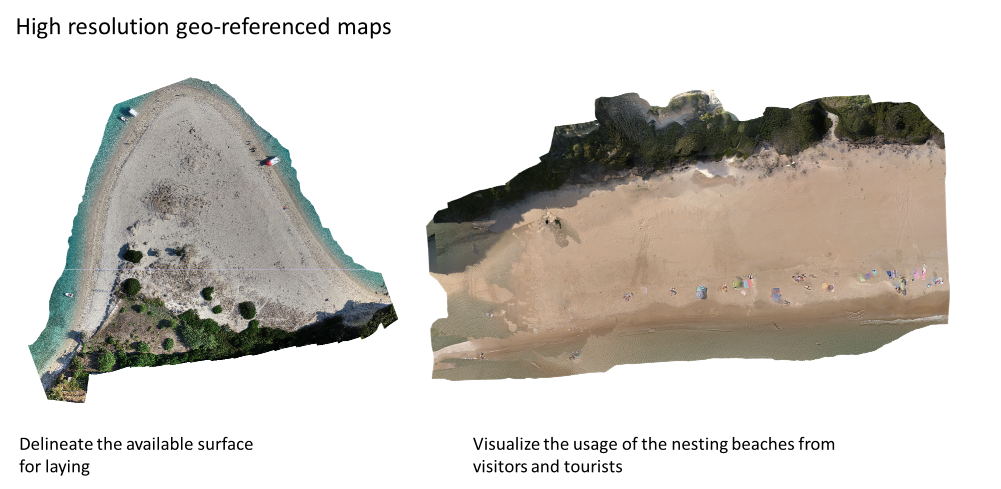
Results

Slide 25
Teşekkür ederim!
Speaker’s name
Speaker’s email address

