Slide 1
HAMID DABASHI
ISLAMIC LIBERATION THEOLOGY

Slide 2
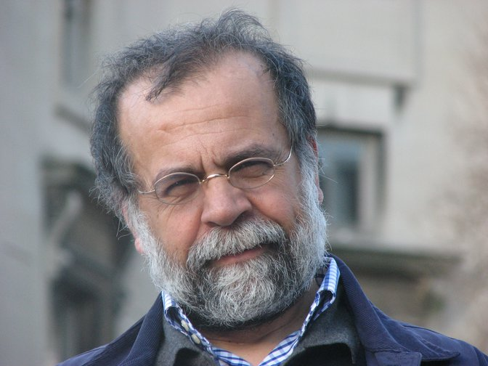

Slide 3
Columbia University professor says Israel almost identical to Islamic State. Hamid Dabashi claims only difference between the two is that the Jewish state has columnists at NY Times to defend its ‘terrorist cause’
— A Columbia University professor wrote on Facebook that the only difference between Israel and the Islamic State jihadist group, is that Zionist columnists defend the Jewish state’s “terrorist cause.”

Slide 4
(CNN) -- A new anti-government movement has sprung up among protesters in Iran -- and now among their supporters in other countries -- with men posting pictures of themselves on the Internet wearing women's head scarves as a political statement. The movement began in recent days as an online backlash after the arrest of one anti-government protester, Majid Tavakoli. The day after his arrest, an Iranian news agency published a picture of Tavakoli dressed in a chador, a black head-to-toe garment worn by Iranian women.

Slide 6
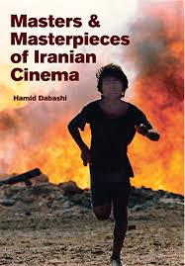
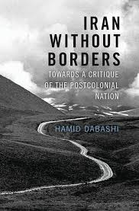
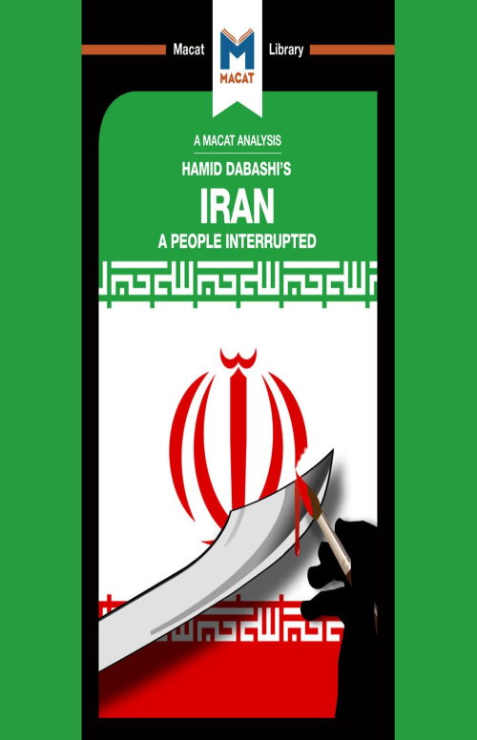

Slide 7
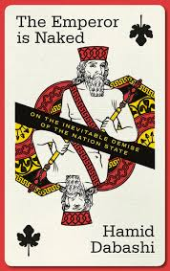
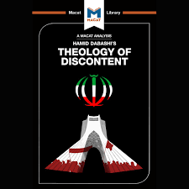

Slide 8
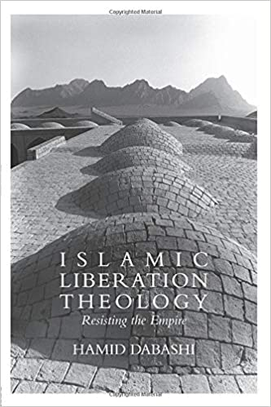
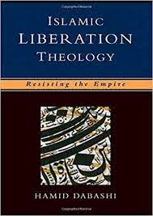

Slide 9
ΠΕΡΙΕΧΟΜΕΝΑ
Introduction
Resisting the empire
The end of Islamic ideology
Blindness and insight
Islam and globalization1
The Shi’i passion play
Liberation theodicy
Malcolm X as a Muslim revolutionary

Slide 10
ALI SHARIATI
Ali Shariati: a master synthesizer, a three-dimensional man? Ali Shariati (1933–1977), born into a religious family, received his doctorate in 1963 from the Sorbonne’s Faculte´ des Lettres et Sciences Humaines, and died in London in 1977. He is widely regarded as the Voltaire of the 1979 revolution. His popularity came to exceed that of almost all other religious and secular intellectuals in pre-revolutionary Iran. And yet, Shariati was ignored by the secularists, admonished by the clerics, and punished by the Shah’s regime... .

Slide 11
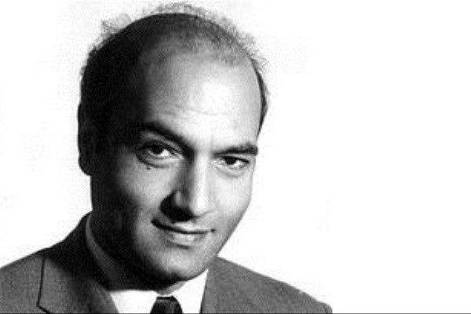

Slide 12
MALCOLM X
https://www.youtube.com/watch?v=ZaVIucxNeTY

Slide 13
MUHARRAM

Slide 14
OSCAR ROMERO AND LIBERATION THEOLOGY
https://www.youtube.com/watch?v=aZ2j9W780Mo

Slide 15
ΚΕΙΜΕΝΑ ΔΙΕΘΝΟΥΣ ΠΟΛΙΤΙΚΗΣ
Πολυθεματικά και πολυεστιακά: πολιτική, ιστορία, κουλτούρα, θεολογία, φιλοσοφία, νομική
Πυκνά, συχνά επιθετικά, με ιδεολογικό βάρος, χιούμορ και πολλά επίπεδα ανάγνωσης
Πολλές και συχνές αλλαγές ύφους και επιπέδων
Τα αγγλικά των «ξένων»

Slide 16
ΚΕΙΜΕΝΑ ΔΙΕΘΝΟΥΣ ΠΟΛΙΤΙΚΗΣ
Ορολογία: παλιοί όροι (discourse, narrative, paradigms)
Δημιουργία νέων όρων (το πρόβλημα της μετάφρασης)

